Slide 1








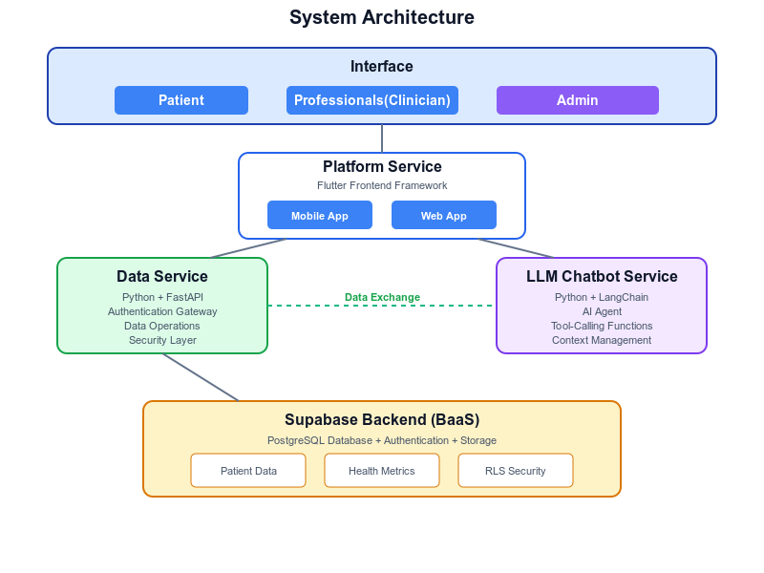
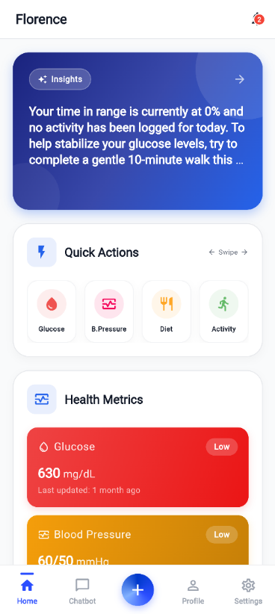
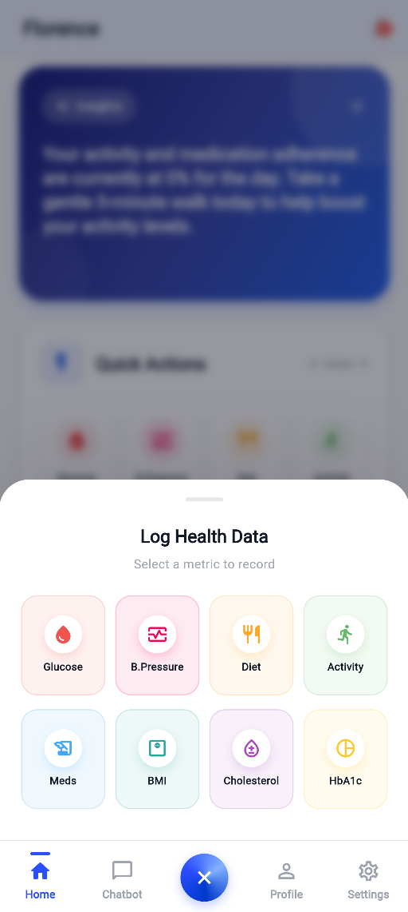
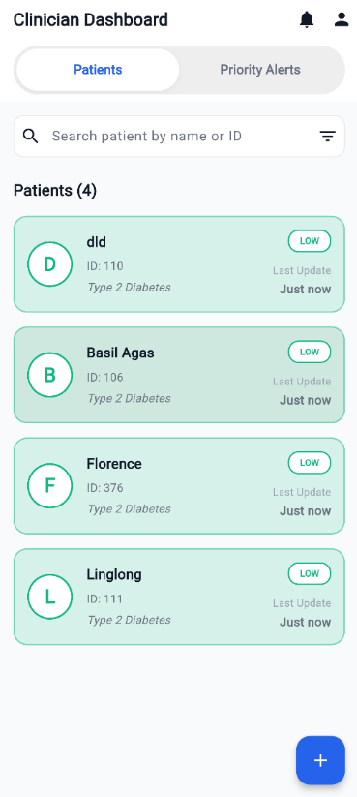
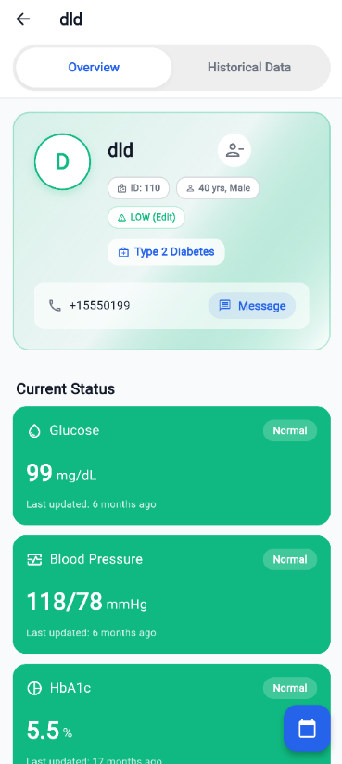
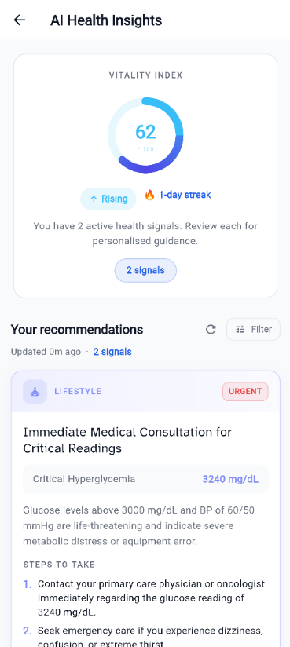
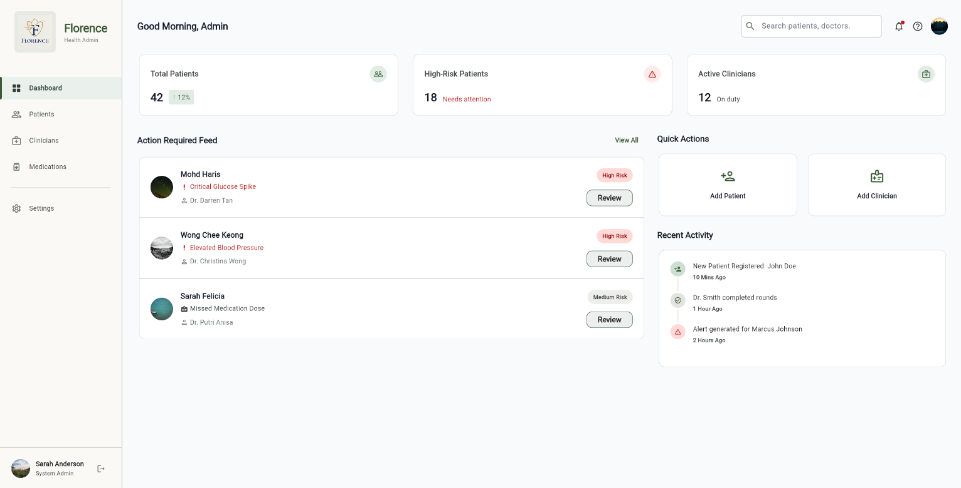







AI-Enabled Digital Health Platform for Chronic Disease Monitoring
Daniel Tiong, Alif Harriz, Ashley Jong, Basil Agas, Edison Ho, Dr. Vong Wan Tze*
Faculty of Engineering, Computing and Science
Swinburne University of Technology Sarawak Campus
wvong@swinburne.edu.my
Introduction
The management of chronic diseases, such as Type 2 Diabetes, is a persistent challenge in modern healthcare. Patients are often overwhelmed by the need to constantly monitor various health metrics (blood glucose, diet, activity) and struggle to interpret this data effectively. Healthcare providers, in turn, lack the tools for real-time monitoring and rely on incomplete, patient-recalled information during infrequent appointments. F.L.O.R.E.N.C.E. aims to transform chronic disease management from a reactive to a proactive approach using an intelligent, AI-enabled digital health platform.
Problem Statement
Core problem: Chronic disease management often depends on patients recording health data manually and clinicians reviewing it later. This creates gaps between daily symptoms, lifestyle patterns, and clinical decision-making. Patient data exists, but it is often fragmented, delayed, and difficult to turn into timely action.
[1][3]
Data is scattered across logs, devices, and apps
Data is reviewed too late, often during appointments
Glucose
Blood Pressure
Medication
Meal
Activity
Readings lack context from meals, medication, and activity
Patients may not know when a trend needs attention
Warning signs can be hidden in long-term records
Care teams need a faster way to identify high-risk patients
Methodology
Patient Dashboard
Quick Logging
Clinician Dashboard
Patient Overview
AI Health Insights
Admin Dashboard
Literature Review
Conclusion
FLORENCE demonstrates how patient health data can be transformed into meaningful insights for both patients and clinicians. By connecting patient logs, AI interpretation, and clinician risk triage, the platform earlier awareness and more targeted care decisions.
High Scalability/AI-Driven
[2][4]
BookDoc
Wellness and Gamification
Activity tracking, non-clinical focus
Unified Tracking
Earlier Warning Signs
Smarter Prioritisation
Reactive/Episodic
Proactive/Continuous
Future Works
DoctorOnCall/Doc2Us
(Resource Intensive)
Transactional Telehealth
On-demand, episodic care
Naluri Health
Human-Coached Programs
Structured programs, human-intensive
Clinical Validation
Wearable & Device Integration
Test FLORENCE with healthcare professionals and representative patient scenarios to evaluate usability, accuracy, and clinical relevance.
Connect with glucose monitors, smartwatches, and other health devices to reduce manual logging and improve data consistency.
Low Scalability/Human-Dependent
Advanced Clinician Dashboard
Enhanced AI Safety
Add deeper filtering, alert management, patient comparison, and trend summaries to support faster clinical decisions.
Strengthen AI guardrails, recommendation quality checks, and medical safety boundaries
References
[1] A. S. Ramli and Y. S. Taher, "Managing Chronic Diseases in the Malaysian Primary Health Care – A Need for Change," Malaysian Family Physician, vol. 3, no. 1, pp. 6–13, 2008.
[2] Grand View Research, "Asia Pacific Digital Health Market Size, Share & Trends Analysis Report By Technology (Tele-healthcare, mHealth), By Component (Software, Hardware, Services), By Region, And Segment Forecasts, 2025 - 2033," 2024.
[3] CodeBlue, "Over Two Million Adults In Malaysia Live With Three NCDs: NHMS 2023," May 28, 2024. [Online]. Available: https://codeblue.galencentre.org/2024/05/over-two-million-adults-in-malaysia-live-with-three-ncds-nhms-2023/
[4] PwC Malaysia, "Healthcare in a Digital Economy: Reimagining the future of HealthTech in Malaysia," 2021.

